Slide 1



2024 Sewer Rate Study
Public Hearing
January 16, 2025

Slide 2
Agenda
Utility Rate Setting 101
Scope of Work
Sewer Enterprise Financial Plan
Project Schedule
2

Slide 3
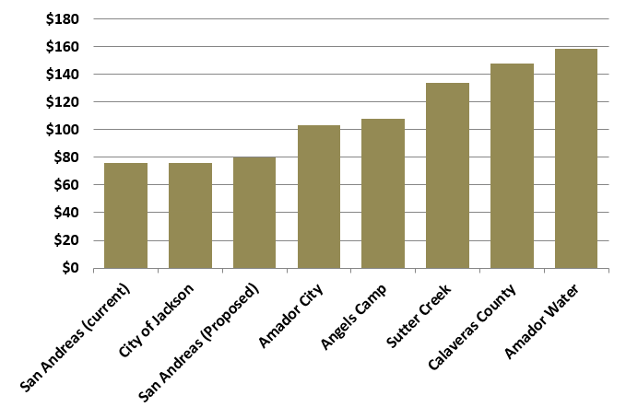
Monthly Sewer Bill Comparisons
Typical Single-Family Homes
3

Slide 4
The Rate Setting Process
Revenue Requirements
Cost-of-Service*
Rate Design*
Compares the revenues of the utility to its expenses to determine the overall level of rate adjustment
Equitably allocates the revenue requirements between the various customer classes of service
Design rates for each class of service to meet the revenue needs of the utility, along with any other rate design goals and objectives
* Not included in scope of work because findings from last study are still applicable.
4
Notes:
10 year is deadline

Slide 5
Legal Requirements for Setting Water Rates In California
Proposition 218 (Article XIIID, Section 6 of California Constitution)
  Revenues shall not exceed funds required to provide service; nor used for another purpose
  Amount shall not exceed the proportional cost of the service attributable to the parcel
  Service must be actually used or immediately available
  Approval process includes 45-day notice, public hearing, and written majority protest. Does not require a voting process (unlike taxes).
5

Slide 6
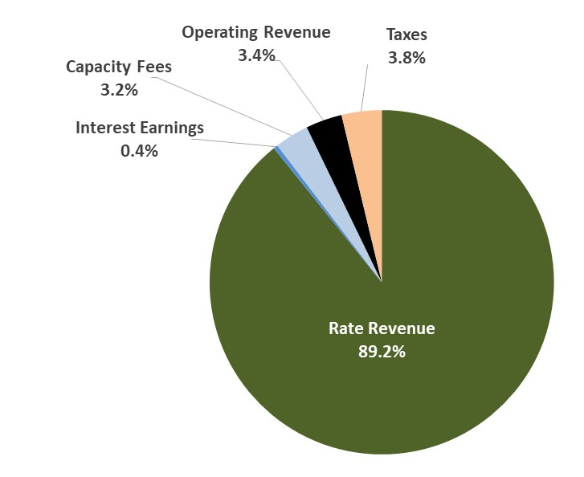
Revenue
FY2024/25 Budget
6

Slide 7
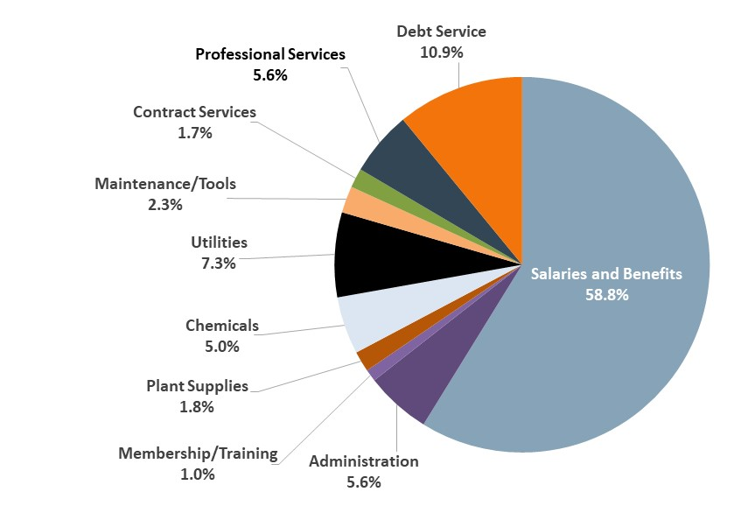
Operating and Debt Expenses
FY2024/25 Budget
*
* Does not include capital spending. All operating costs are assumed to inflate by 3% per year for the next 10 years.
7

Slide 8
Recommended Reserve Targets
Strong financial practices/policies are in the interest of rate payers and contribute towards the District’s credit rating.
    Reserve policies serve to protect the District against unforeseen circumstances:
    Operating Reserve: For changes in operating costs or disruption in revenue. Target = 3 months of O&M budget (currently $477,000)
    Emergency Reserve: Ensures timely response to natural disasters and/or other emergencies. Target = 50% depreciation expense (currently $375,000)
    Equipment Replacement Reserve: Ensures timely replacement of District equipment.
    Target = Following year's budgeted replacement budget (average target = $100,000)
    Capital Reserve: Positions the District to receive grants by funding grant writing, preliminary engineering studies, and environmental documents. Target = $300,000.
    Debt Reserve: Required by most lenders to keep one year of debt service in reserves. Current reserve = $210 thousand
    Total Target = $1.45 million
8

Slide 9
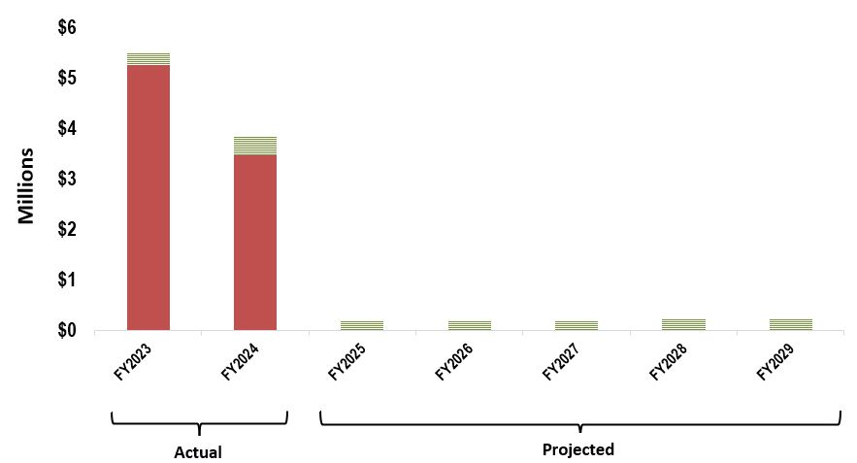
Projected Capital Spending
= Grant Financed
= Cash Financed
Cash-Funded Capital:
Historical: $299 thousand per year
Projected: $200 thousand per year, then increasing to $300 thousand in FY2030
Annual depreciation expense is $450 thousand
9

Slide 10

Financial Forecast & Proposed Rate Revenue Increases
Additional Rate Revenue
Existing Rate Revenue
Non Rate Revenue
Cash Capital
Debt Service
Debt Service
Operating Expenses
*
10
    * Debt Coverage Ratio measures whether the District can afford its debt obligations. Minimum levels are 1.2 and target levels are 1.5.
Notes:
.

Slide 11
Rate Increase Options at Board’s Discretion
    The Board recognizes that the District’s actual future capital spending may be less than assumed by the financial plan ($200 thousand per year in the near-term and $300 thousand per year starting in FY2030.)
    In the event that the District cash reserves grow more than forecasted because either (1) capital spending is lower than projected or (2) operating costs increase less than projected, the Board intends to implement rate increases that are lower than the maximum annual increase (5 percent per year).
11

Slide 12
5-Year Rate Schedule (with 5% rate increases)
12

Slide 13
Monthly Sewer Bill Comparisons
Typical Single-Family Homes
13

Slide 14
Next Steps
Receive public comment
Close Public Hearing
Board deliberation
Tally protest votes
Board vote on proposed rates (only if protest count is below 50 percent)
If passed, the first rate increase will occur July 1, 2025
14

